Slide 1

Voice-Assisted Multilingual Form-Filling Assistant Project
RASHMI

Slide 2
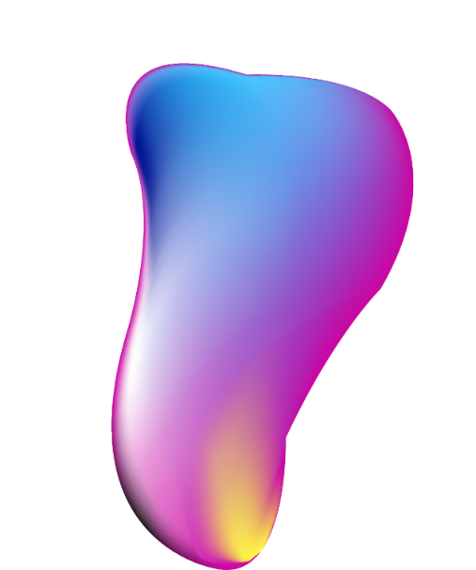


CONTNTES
01
02
03
Project Overview
Objectives and Goals
Technical Architecture
04
05
06
Key Features
Demonstration and Workflow
Challenges

Slide 3

Introduction to the Project
Brief Description
This project focuses on developing an innovative voice-assisted assistant that enables users to fill out forms in multiple languages, thereby enhancing accessibility and efficiency for users of diverse linguistic backgrounds.

Slide 4

Problem Statement
01.
02.
Challenges in Form Filling
Proposed Solution
Users often face challenges like accessibility for differently-abled individuals, language barriers for non-native speakers, and the tedious nature of manual data entry, which can be both time-consuming and error-prone.
The proposed solution is a voice-assisted tool that simplifies the form-filling process across various languages, making it easier for everyone, especially those with disabilities or language limitations, to complete forms accurately and efficiently.

Slide 5
Objectives and Goals
Develop Interactive Interface
Integrate Multilingual Support
Ensure Data Accuracy
The objective is to create an intuitive and interactive user interface that allows users to fill forms by speaking, providing a smoother and more engaging experience.
The project aims to incorporate support for multiple languages so that users can interact with the assistant in their preferred language, enhancing usability and accessibility.
A key goal of the project is to implement mechanisms that ensure maximum transcription accuracy, minimizing errors during data entry and improving overall user satisfaction.

Slide 6
Target Audience
General Public
Differently-Abled Users
Additionally, this tool is designed for the general public who may face language barriers or wish to simplify the form-filling process for various applications.
One of the primary target groups includes differently-abled individuals who may find traditional form-filling processes challenging, thus benefit immensely from voice assistance.

Slide 7
Technical Architecture
Frontend Technologies
Third-Party Integrations
The frontend of the application will be developed using HTML, CSS, and JavaScript, providing users with a dynamic and interactive experience when filling out forms.
Integration with third-party services such as Whisper model for voice recognition and transcription will enhance the system's capability in processing voice inputs to text efficiently.
Backend Technologies
The backend will utilize the Flask framework in Python, serving the application logic and handling data requests between the front and backend effectively.

Slide 8
Key Features
Multilingual Capabilities
By supporting multiple languages, the tool provides flexibility and inclusivity for users from diverse linguistic backgrounds, fostering a broader user base.
Voice-Assisted Input
This feature allows users to fill out forms using voice commands, which are converted into text, facilitating a hands-free and efficient data entry process.
Real-time Feedback
The system will offer real-time feedback to users, including error notifications and updates on the transcription process, ensuring clarity and accuracy in form entries.

Slide 9
Design Principles
Responsive Design
Responsive design principles will ensure that the application is accessible on various devices (desktops, tablets, smartphones), adapting seamlessly to different screen sizes.
User-Friendly Interface
The interface will focus on simplicity and ease of navigation, ensuring that users can easily understand and utilize the voice-assisted features without extensive training.

Slide 10



Demo Steps
1
2
3
Recording Audio
Transcription Process
Auto-Populating Fields
The demo will begin with users clicking a "Record" button to capture their voice input for specific form fields, showcasing the voice activation functionality.
After recording, the audio will be transmitted to the server where the Whisper model processes the voice to convert it into text for accurate data entry.
Once transcription is complete, the corresponding form fields will be auto-populated with the transcribed text, requiring user confirmation before final submission.

Slide 11
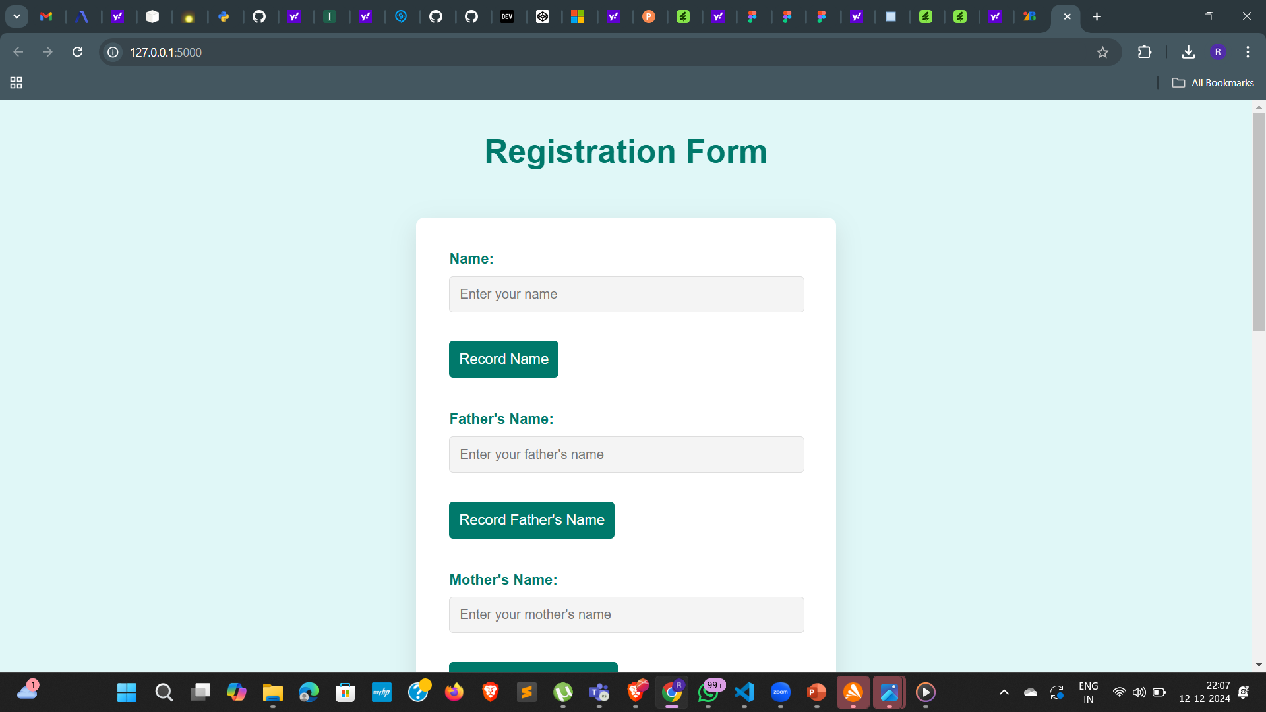
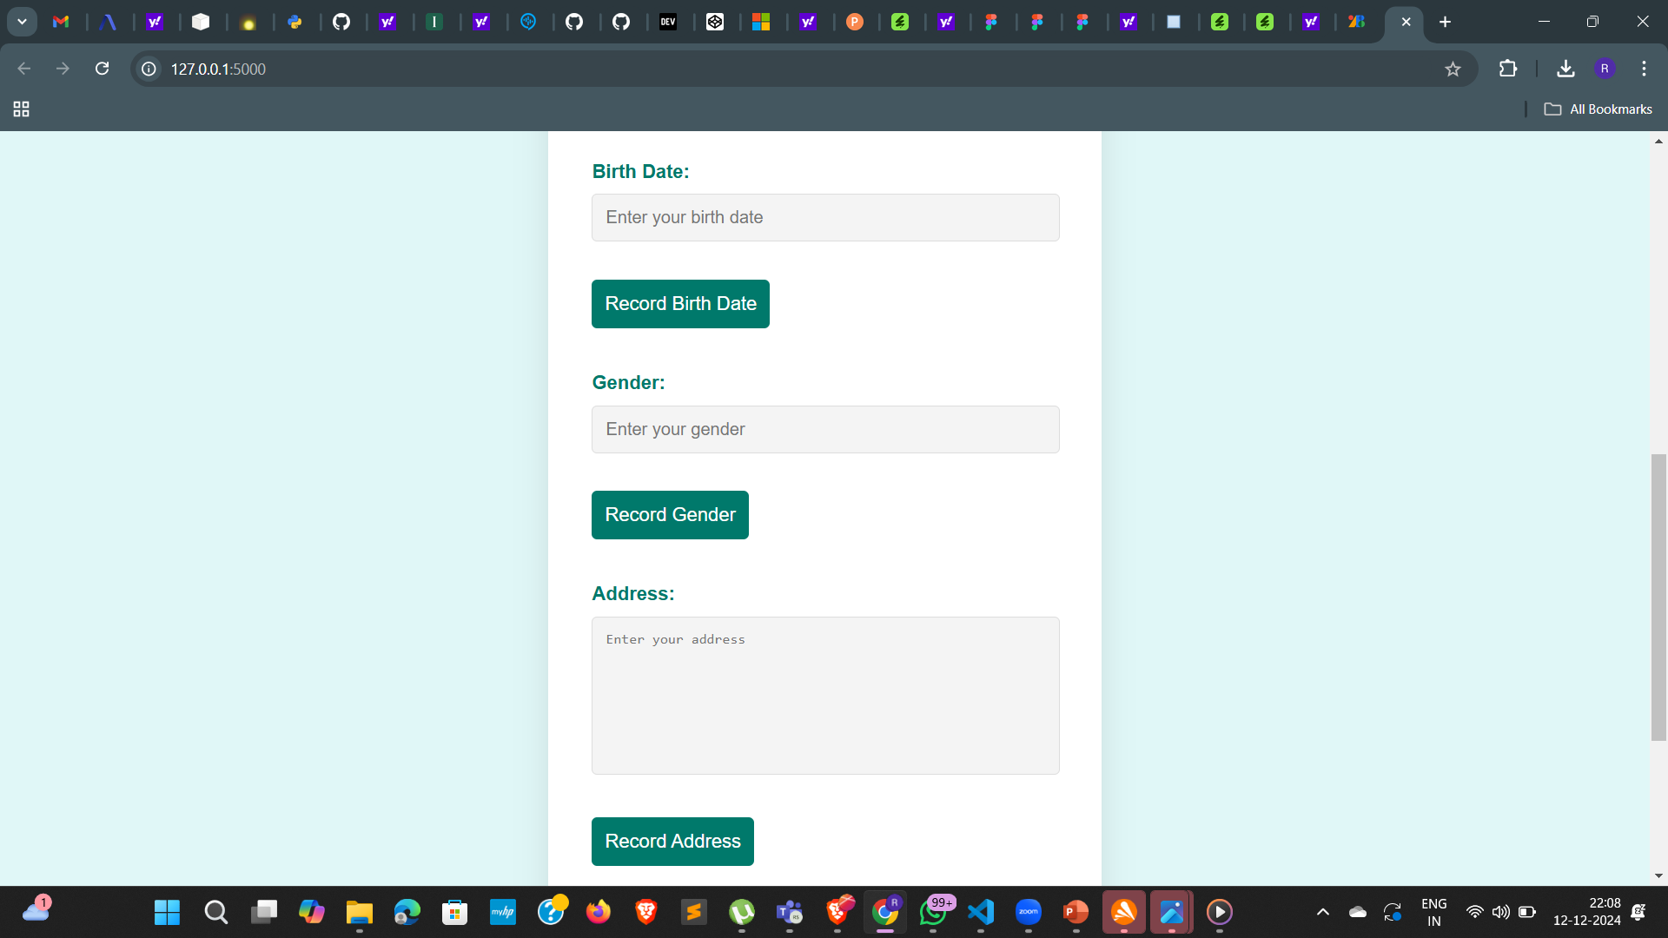
Screenshots
Interface Example

Slide 12
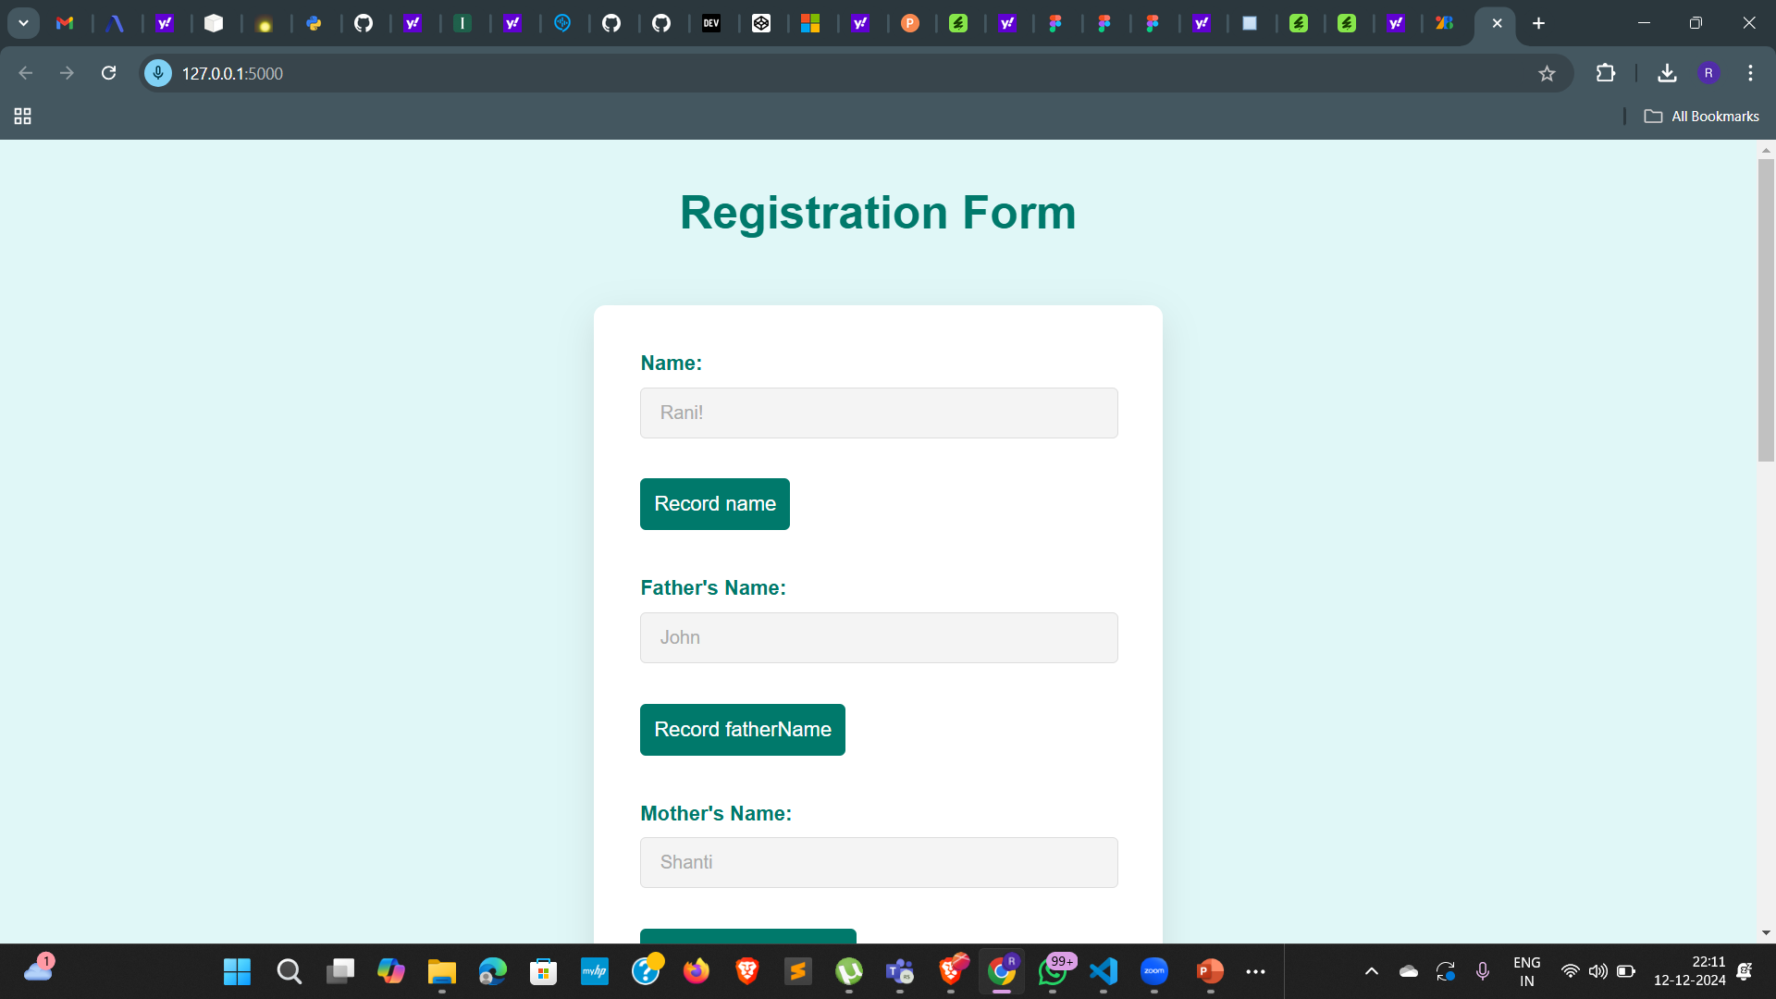
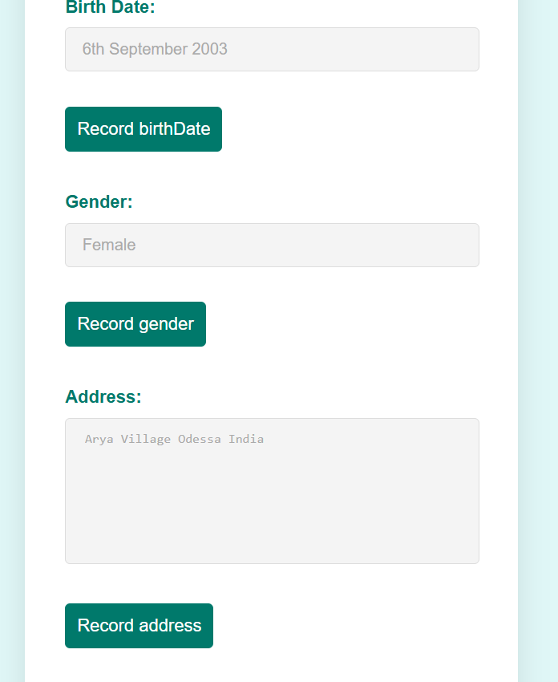
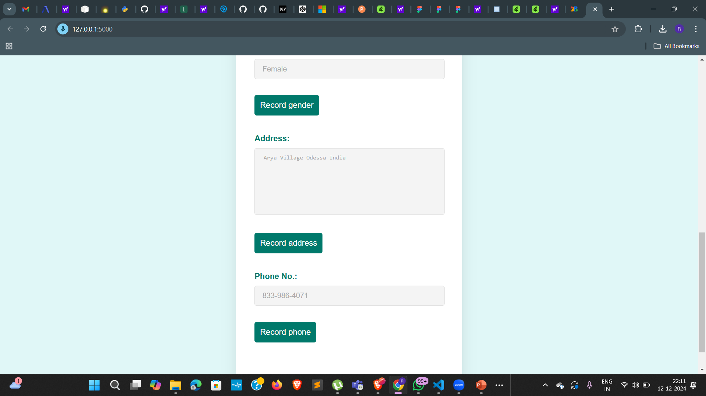
Screenshots
Transcription Example

Slide 13



Challenges Faced
01
02
03
Real-Time Processing Issues
Transcription Accuracy
Integration Difficulties
Managing real-time processing of audio files poses challenges such as latency and ensuring that users receive immediate feedback during their interactions.
Achieving high transcription accuracy across multiple languages is a significant challenge, requiring robust models and constant refinement of the processing algorithms.
Integrating the backend with the frontend effectively while ensuring a smooth user experience has proven to be complex and involves troubleshooting various technical issues.

Slide 14
THANK YOU
-RASHMI SAHOO
Reporter

